Slide 1
Regression analysis in Excel - the basics
Nabajyoti Pathak

Slide 2
Basic of Linear Regression
In statistical modeling, regression analysis is used to estimate the relationships between two or more variables:
Dependent variable (aka criterion variable) is the main factor you are trying to understand and predict.
Independent variables (aka explanatory variables, or predictors) are the factors that might influence the dependent variable.

Slide 3
Basics
Regression analysis helps you understand how the dependent variable changes when one of the independent variables varies and allows to mathematically determine which of those variables really has an impact.

Slide 4
Linear regression equation
Mathematically, a linear regression is defined by this equation : y = bx + a + ε
x is an independent variable.
y is a dependent variable.
a is the Y-intercept, which is the expected mean value of y when all x variables are equal to 0. On a regression graph, it's the point where the line crosses the Y axis.
b is the slope of a regression line, which is the rate of change for y as x changes.
ε is the random error term, which is the difference between the actual value of a dependent variable and its predicted value.

Slide 5
How to do linear regression in Excel with Analysis ToolPak

Slide 6
Enable the Analysis ToolPak add-in
Analysis ToolPak is available in all versions of Excel 2019 to 2003 but is not enabled by default.
So, you need to turn it on manually.
Here's how:
In your Excel, click File > Options.
In the Excel Options dialog box, select Add-ins on the left sidebar, make sure Excel Add-ins is selected in the Manage box, and click Go.

Slide 7
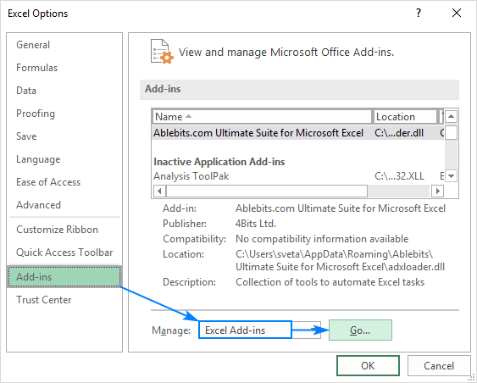
Enable the Analysis ToolPak add-in

Slide 8
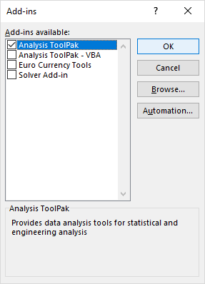
Analysis Toolpak
This will add the Data Analysis tools to the Data tab of your Excel ribbon.

Slide 9
Run regression analysis
With Analysis Toolpak added enabled, carry out these steps to perform regression analysis in Excel:
On the Data tab, in the Analysis group, click the Data Analysis button.
Select Regression and click OK.
In the Regression dialog box, configure the settings as shown in next slides

Slide 10
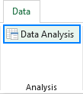
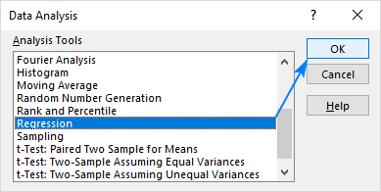
Run Regression Practical

Slide 11
Regression dialog box
In the Regression dialog box, configure the following settings:
Select the Input Y Range, which is your dependent variable. In our case, it's umbrella sales (C1:C25).
Select the Input X Range, i.e. your independent variable. In this example, it's the average monthly rainfall (B1:B25).
If you are building a multiple regression model, select two or more adjacent columns with different independent variables.
Check the Labels box if there are headers at the top of your X and Y ranges.
Choose your preferred Output option, a new worksheet in our case.
Optionally, select the Residuals checkbox to get the difference between the predicted and actual values.

Slide 12
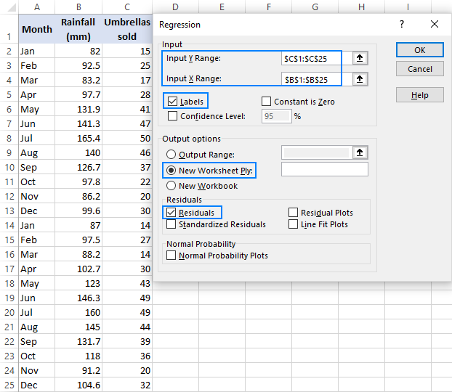
Regression dialog box(cont)
Click OK and observe the regression analysis output created by Excel.

Slide 13
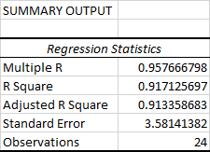
Regression analysis output: Summary Output

Slide 14
Thank you

